Slide 1
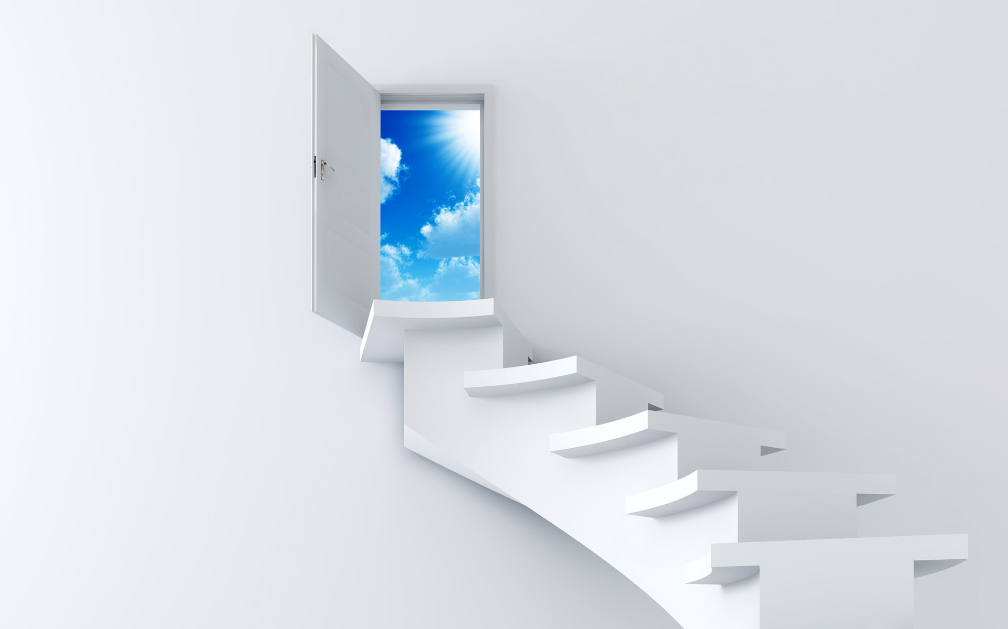

Welcome to our class
Grade 9

Slide 2
Lesson 1 : Introduction
1.Note book : 2
2.Syllabus : 2 periods/ a week
3.Note :
- Learn vocabulary
- Do a lot of homework ( teacher’s exercises ,
on the internet …….)
- Try your best

Slide 3
WEDNESDAY , SEPTEMBER 8th , 2021
UNIT 1: A VISIT FROM A PEN PAL

Slide 4


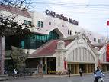

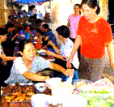
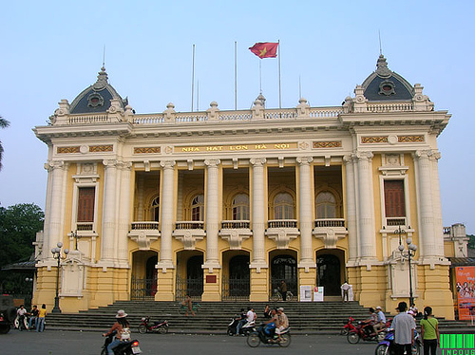
Getting started:
.
What activities would you do during the visit?
Hung’s Temple
The Temple of Literature
Dong Xuan Market
History Museum
Eating out
Ha Noi Opera House

Slide 5
I. VOCABULARY
1.friend (n)
friendly # unfriendly (adj)
friendliness (n)
friendship (n)
2.correspond ( with sb )
correspondence (n)
correspondent (n)
3.impress (v)
impressive (adj) # unimpressive
impressively (adv)
impression (n)
make a good impression on sb
be impressed by
4.mausoleum (n)
5.mosque (n)
6.Temple of Literature

Slide 6
7.atmosphere (n)
8.pray (v)
prayer (n)
9.depend ( on ) (v)
dependence (n)
# independence (n)
dependent ( on ) (adj)
# independent ( of ) (adj)
dependently (adv)
10.worship (v) / (n)
11.recreation (n)

Slide 7


II. Listen and read
Lan’s Malaysian pen pal, Razali Maryam, was staying with Lan last week. Maryam is from Kuala Lumpur. Maryam and Lan have been pen pals for over two years and they correspond at least once every two weeks, but this was their first meeting.
On Maryam's first day in Ha Noi, Lan took her to Hoan Kiem Lake. Like Kuala Lumpur, Ha Noi is a busy modern city. Maryam was really impressed by the beauty of the city and by the friendliness of its people.
Over the next few days, the girls visited Ho Chi Minh's Mausoleum, the History Museum and the Temple of Literature, as well as many beautiful parks and lakes in Ha Noi. On Friday, Maryam wanted to visit the mosque on Hang Luoc Street. Lan used to walk past the mosque on her way to primary school. However, this was Lan’s first visit. She enjoyed the peaceful atmosphere while Maryam was praying.
“I wish you had a longer vacation,” Lan said to Maryam at the end of the week.
“Yes, I wish I had more time to get to know your beautiful country better. Lan, would you like to come and visit me next summer?” Maryam asked.
“That would be great! However, it seems very difficult for me to have a trip abroad. It all depends on my parents. Anyway, we’ll keep in touch.”

Slide 8
Choose the correct option
1. Lan and Maryam usually write to one another every…
A. two years.
B. month.
C. two weeks.
D. day.
2. Maryam was impressed because…
A. Hanoi was big and modern.
B. Hanoi people were friendly.
C. Hanoi was different from Kuala Lumpur.
D. Hanoi and Kuala Lumpur were the same.

Slide 9
3. The girls went to see…
A. famous places in Hanoi.
B. areas for recreation.
C. a place of worship.
D. all the above.
4. Maryam wanted to…
A. visit Hanoi the next summer.
B. invite Lan to Kuala Lumpur.
C. stay in Hanoi.
D. Visit Ho Chi Minh city.

Slide 10
Guiding questions
1. Where did Lan take Maryam to?
Lan took Maryam to:
Hoan Kiem Lake
Ho Chi Minh’s Mausoleum
the History Museum
the Temple of Literature
many beautiful lakes and parks in Ha Noi.
the mosque on Hang Luoc Street

Slide 11
Comprehension questions
1. Where is Maryam from?
2.How long have they been pen pals?
3.Were Hanoi and Kuala Lumpur different?
Kuala Lumpur - Malaysia
For over 2 years
No, they weren’t. they were the same.
. 4. Did Maryam enjoy Hanoi? Why?
Yes, she did. Because of people’s friendliness, beautiful places,

Slide 12
II. GRAMMAR :
1. The past simple tense : ( Thì quá khứ đơn )
Thì quá khứ đơn diễn tả một sự việc xảy ra tại một thời điểm cụ thể trong quá khứ và đã kết thúc hoàn toàn ở quá khứ.
Dấu hiệu : last + thời gian; khoảng thời gian + ago; in + thời gian trong quá khứ; this morning…
Cấu trúc : ( + ) S + ( was / were ) / V2/ed + O
( - ) S + ( wasn’t / weren’t ) / didn’t + V1 + O
( ? ) (Was/ Were)/ Did + S + V1 + ……. ?
.

Slide 13
II . THE WISH SENTENCES
Form: S1+ Wish(es) + S2 + V2/ed …..
Be → Were / Ordinary verbs → Simple past
Ex: I wish Lan were here now.
Minh wishes he worked for Ha Noi newspaper now.

Slide 14
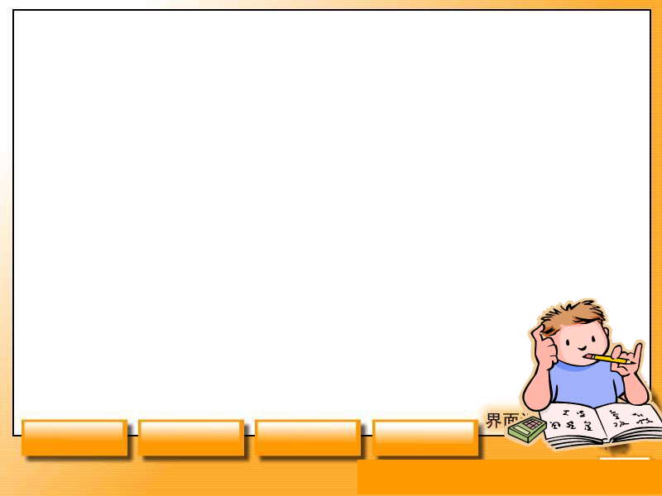
1. Learn the new words and the wish sentences by heart
HOMEWORK
-Read the text again at home
- Prepare Speak + Listen page 8.

